Slide 1
Capstone Project:
RL Sales Prediction
Week 6 Progress Report

Slide 2
Recap

Slide 3
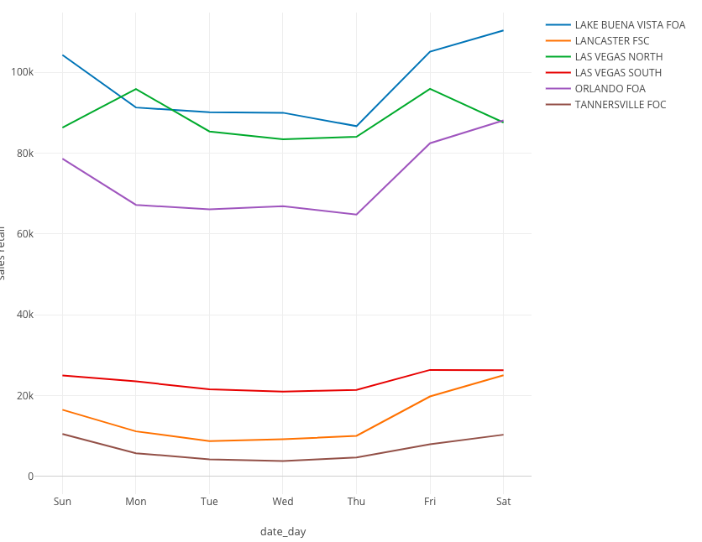
Weekly Trend
Boost on weekends
Las Vegas North
Boost on Monday

Slide 4
Agenda for Today
Baseline models for Orlando FOA
Context research: demographics

Slide 5
Two Model Approaches
Causal Impact Algorithm
Build a series of baseline models
Subtract the baselines from the original time series to get the effects of events
Regression Analysis
Y = sales_retail
X = factors
Models
Linear (baseline)
Polynomial
Support Vector
Decision Tree
Random Forest

Slide 6
Causal Impact Algorithm
Built baselines for `holiday` and `promotion day`

Slide 7
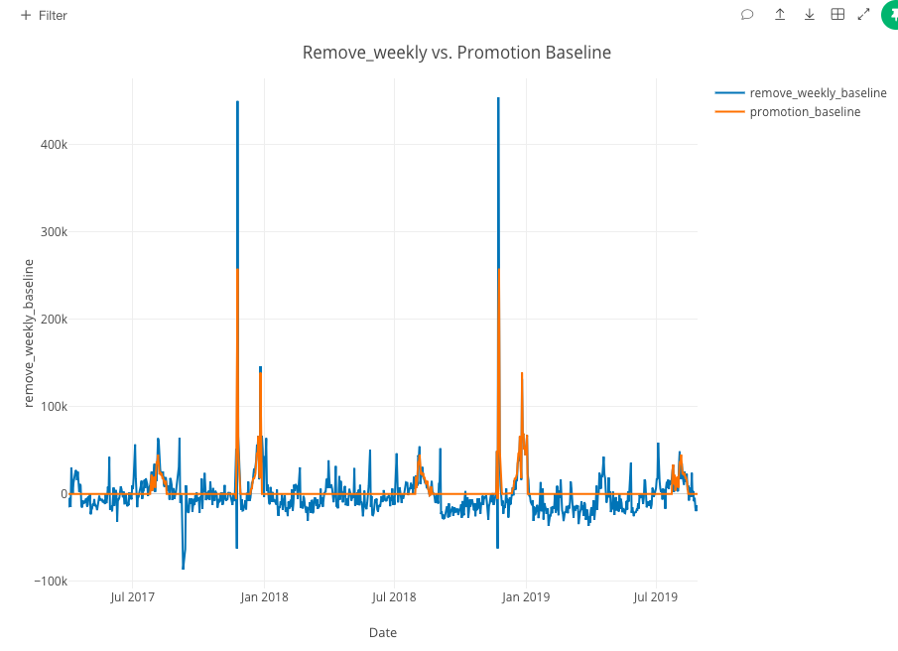
Promotion day baseline model with weekly trend removed.

Slide 8
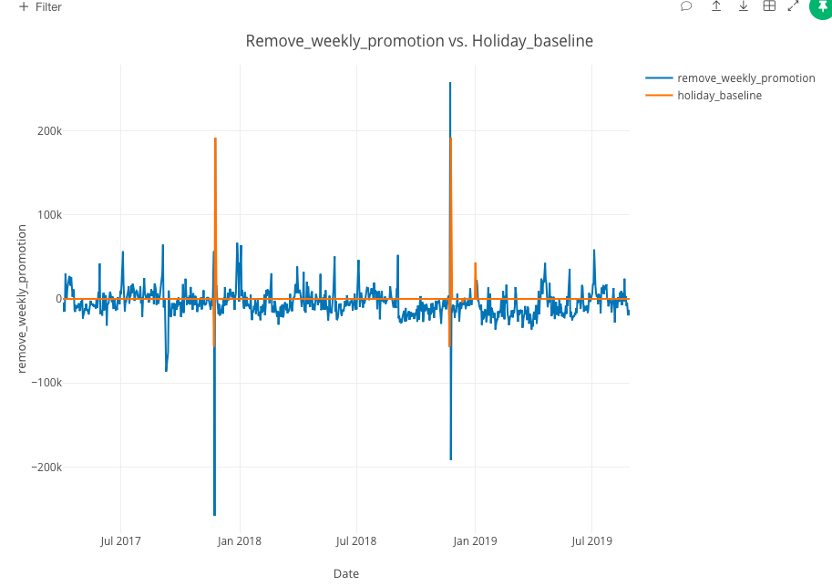
Holiday baseline model with weekly trend and effect of promotion day removed.

Slide 9
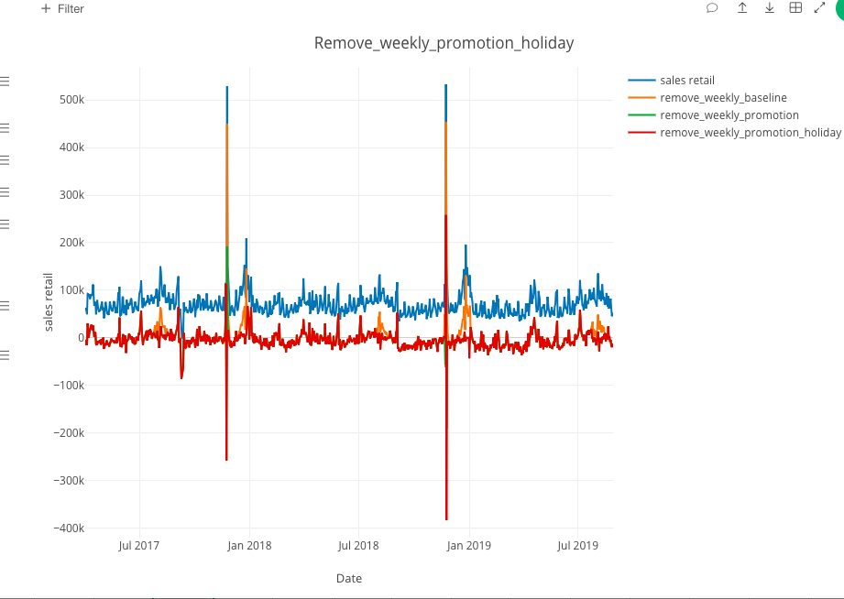
Overall baseline model with weekly trend, holiday and promotion day effects removed.

Slide 10
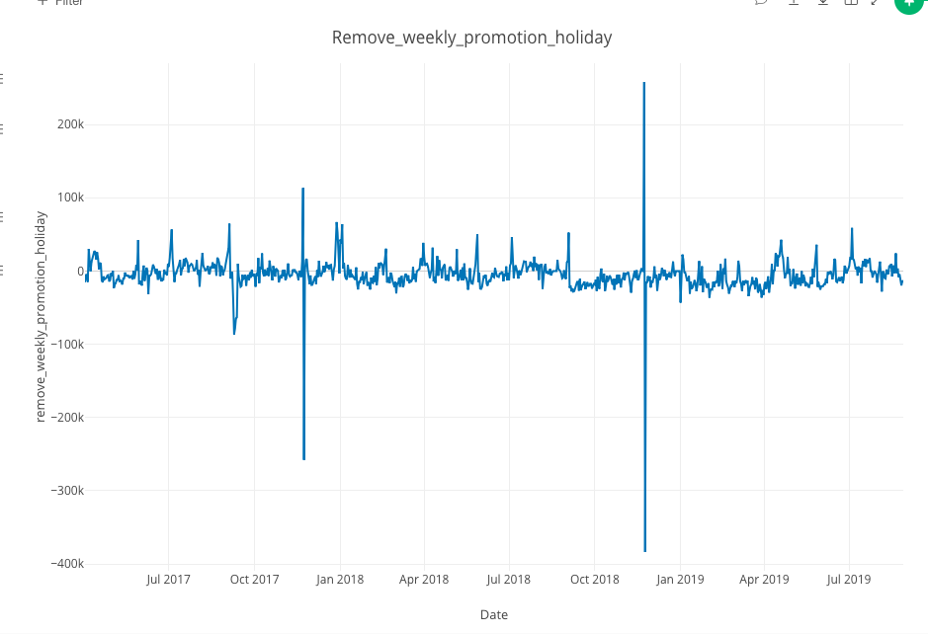
Overall baseline model with weekly trend, holiday and promotion day effects removed.

Slide 11
Regression Analysis
Scope: FY 2020 - Aug/Sept, Orlando FOA
Target
One aggregated sum for each day
Features
'month', 'is_promo', 'is_holiday', 'traffic', 'food_drink',
# of events for each category ('business_professional', 'other', 'health_wellness', 'film_media_entertainment', 'family_education', 'school_activities')
'total_events'
Model: simple linear regression model
R^2 = 0.95
95% of variance in sales_retail is explained by the model.

Slide 12
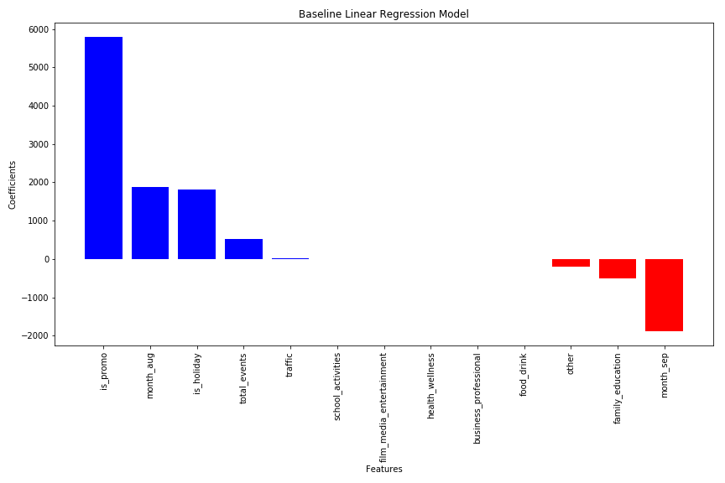
Baseline Linear Regression Model
Notes:
Even with Aug/Sept, online free event data have limited availability
Zero coefficients, mostly because of missing values
13 events out of the 2-month range (scarce data)
Promotion days/holidays have large positive weights
Family/education events are negatively correlated with sales
Month_aug cancels out the effect of month_sept

Slide 13
Context Research:
Demographics
Notes:
Goal: draw insights for significant events/factors that contribute to sales
http://worldpopulationreview.com/us-cities/

Slide 14
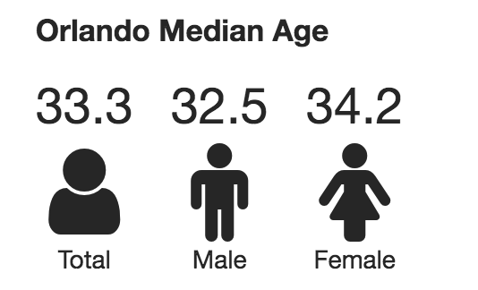
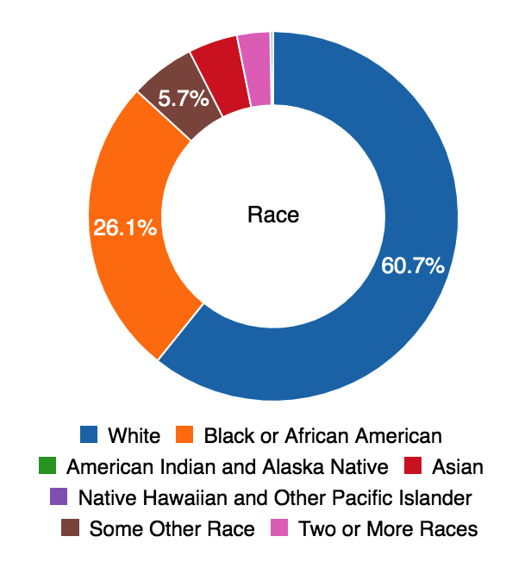
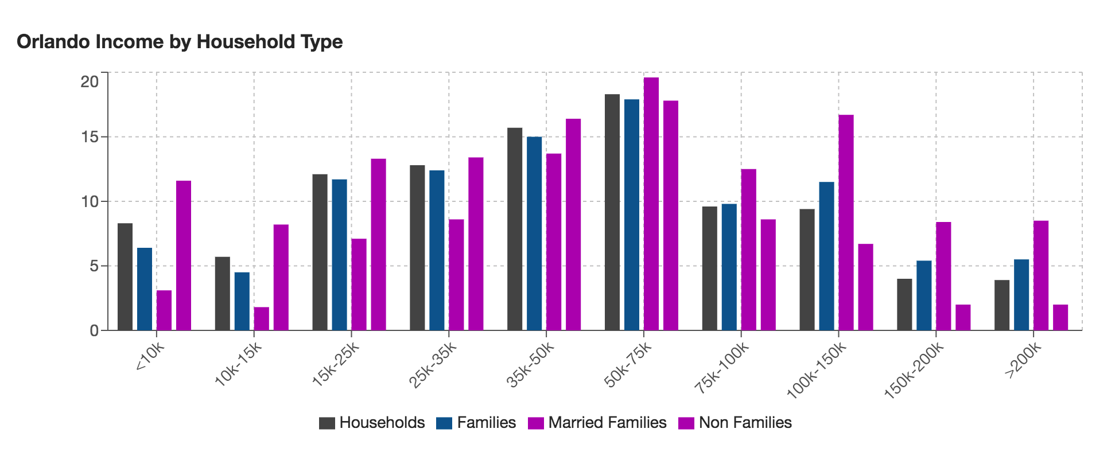
ORLANDO
ORLANDO FOA/LAKE BUENA VISTA FOA
Middle Class
High
Income
Notes:
Demographics
Median age: 33
Economy
High-tech center
Tourism industry
Walt Disney World Resort, Universal Orlando Resort, SeaWorld

Slide 15
#1. Business & Professional
#2. Food & Drink
#3. Music
#4. Health & Wellness
#5. Charity & Causes
Notes:
Top category for events
2019.09.15-

Slide 16
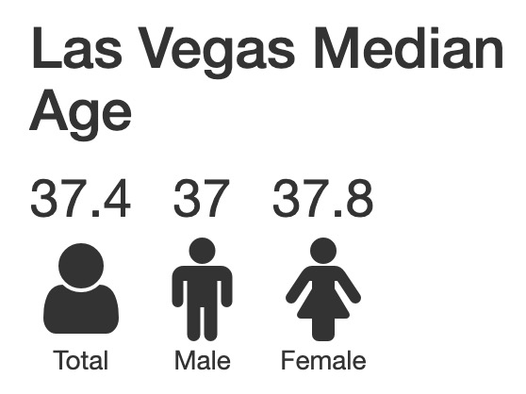
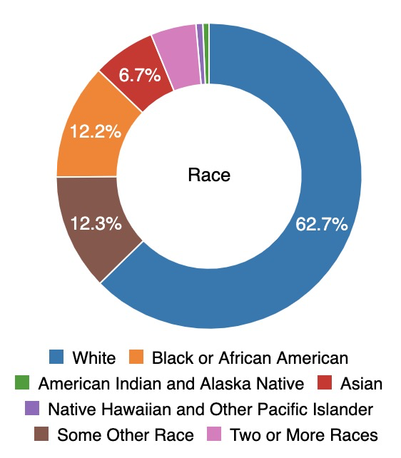
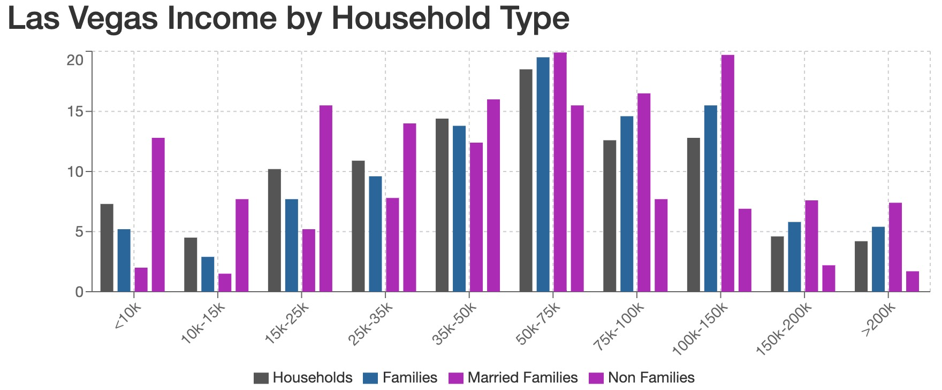
LAS VEGAS
LAS VEGAS NORTH/LAS VEGAS NORTH SOUTH
Middle Class
High
Income

Slide 17
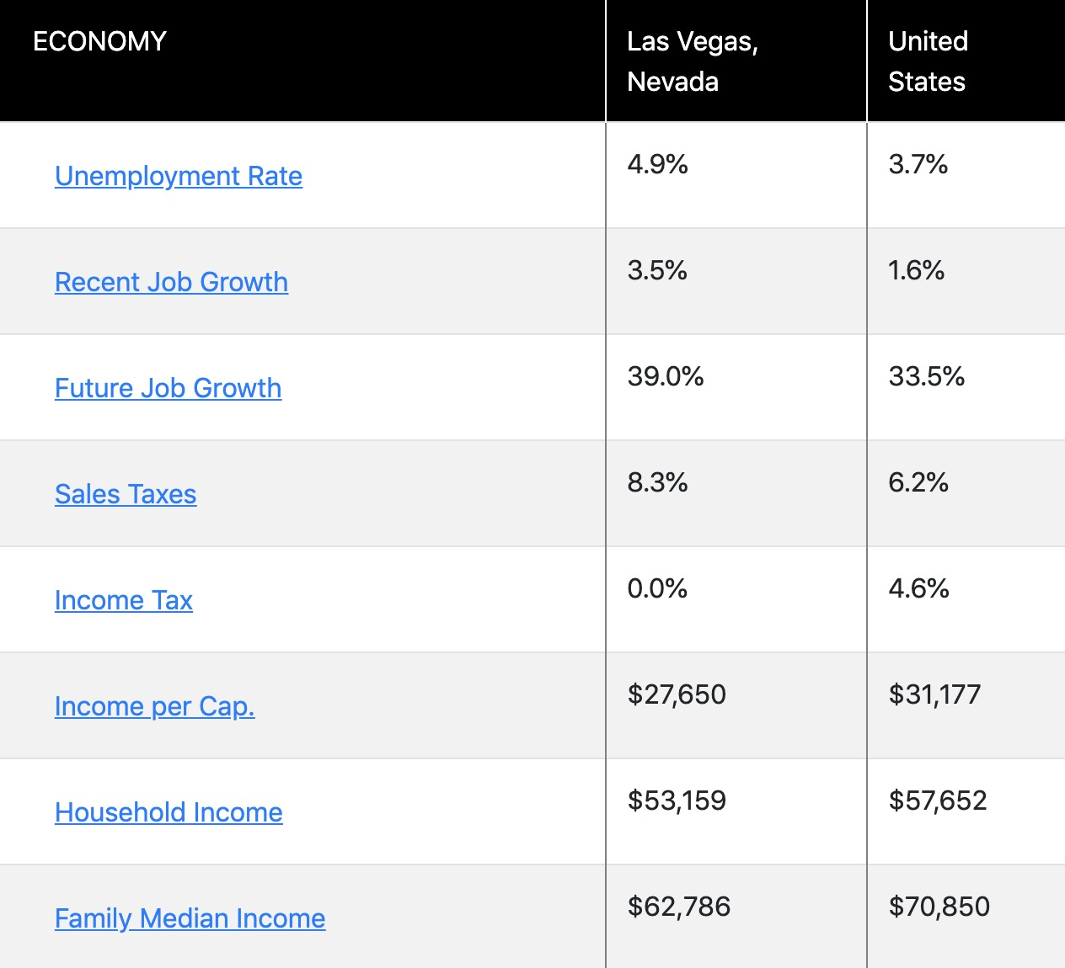
Economy

Slide 18
#1. Food & Drink
#2. Music
#3. Business & Professional
#4. Other
#5. Health & Wellness
#6. Performing & Visual Arts

Slide 19
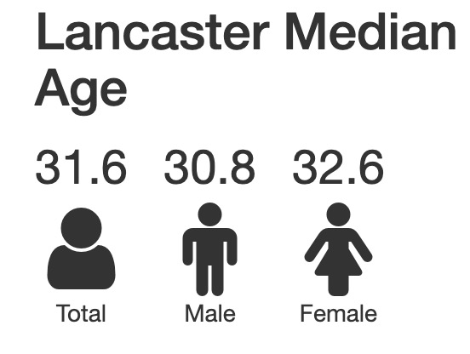
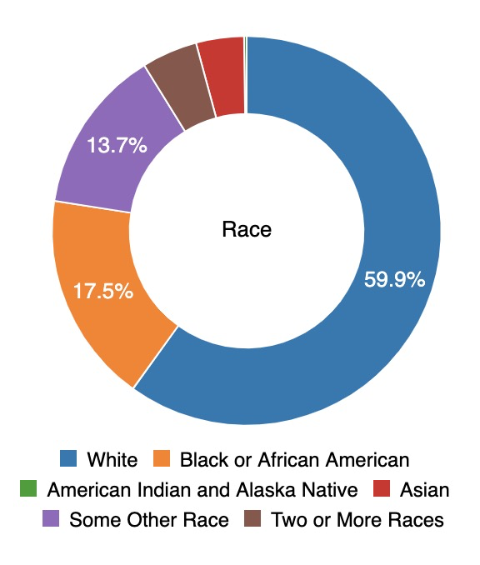
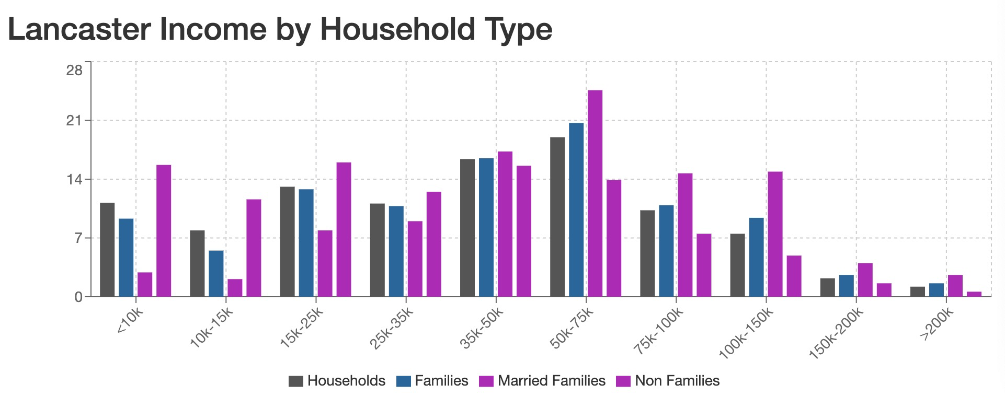
LANCASTER
LANCASTER FSC
Middle Class
High
Income

Slide 20
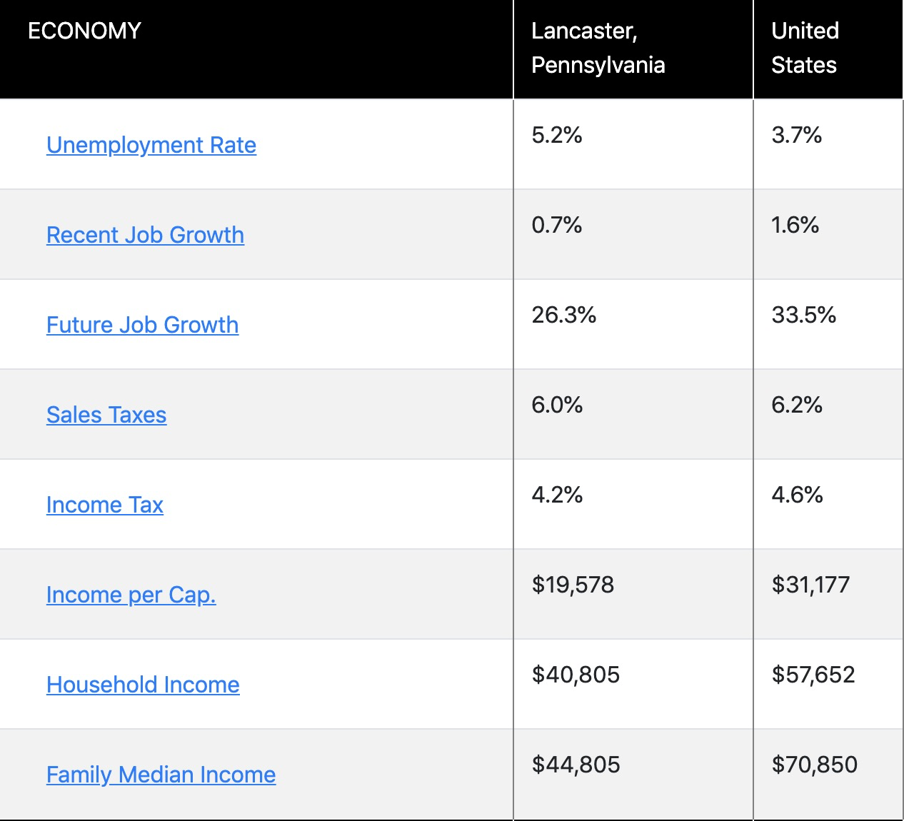
Economy

Slide 21
#1. Music
#2. Business & Professional
#3. Health & Wellness
#4. Charity & Causes
#4. Performing & Visual Arts

Slide 22
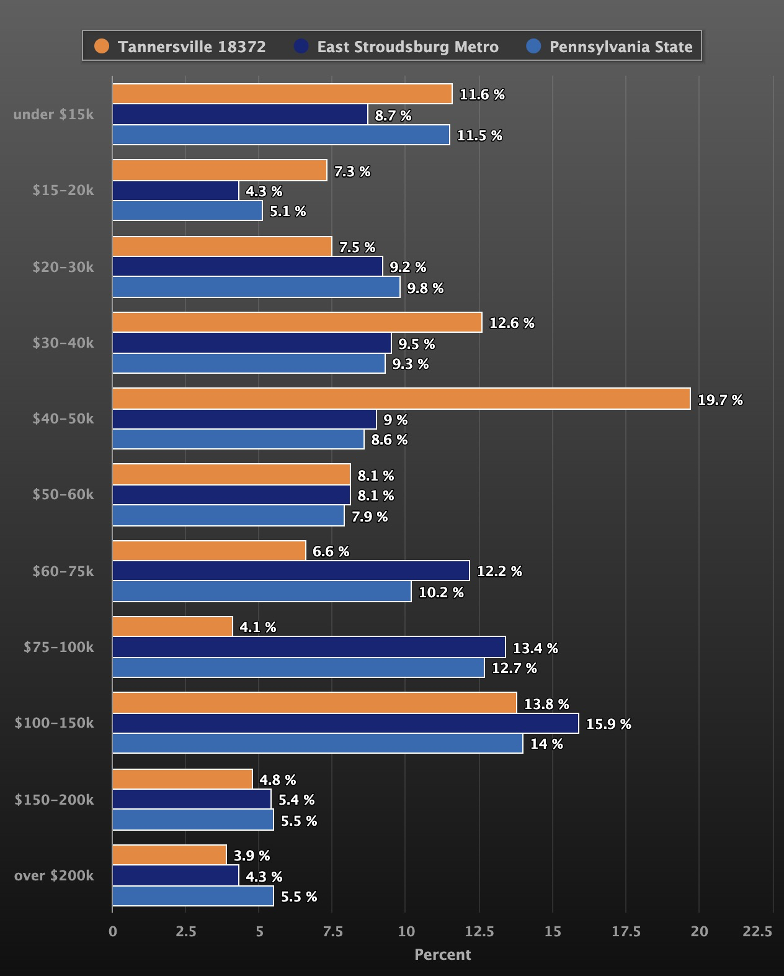
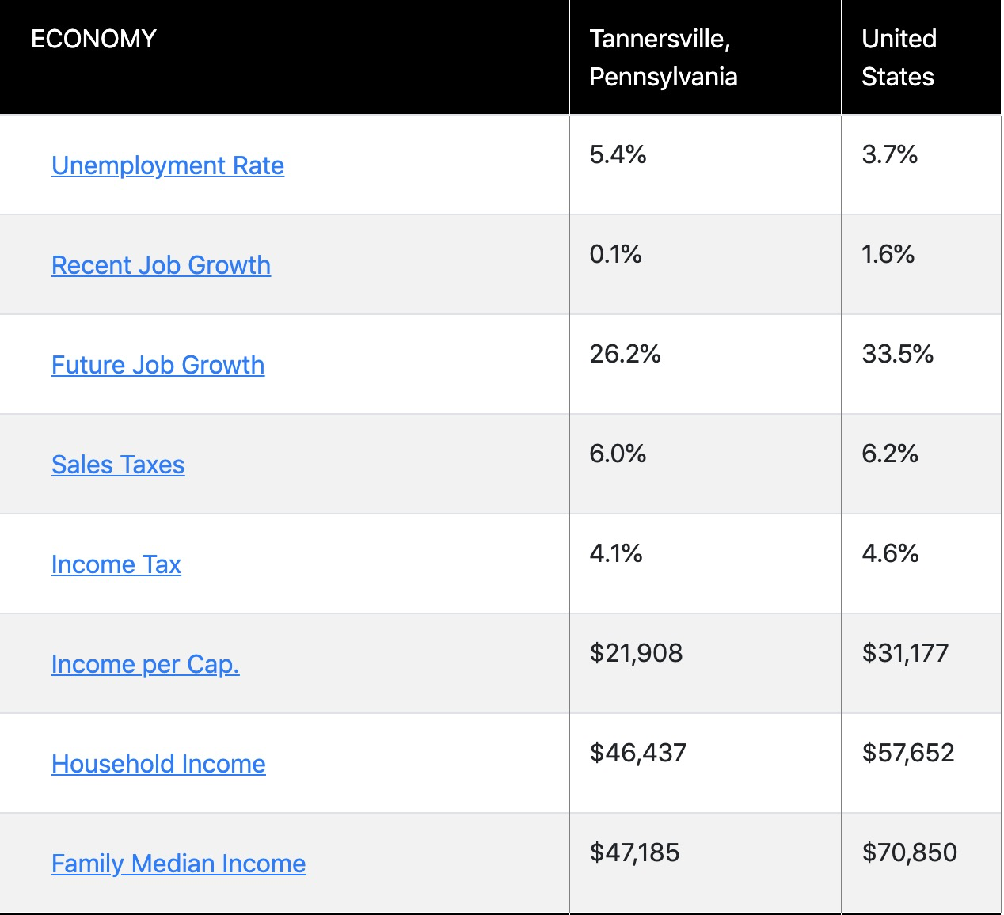
TANNERSVILLE
TANNERSVILLE FOC

Slide 23
#Hobbies & Special Interest
Notes:
One record only.

Slide 24
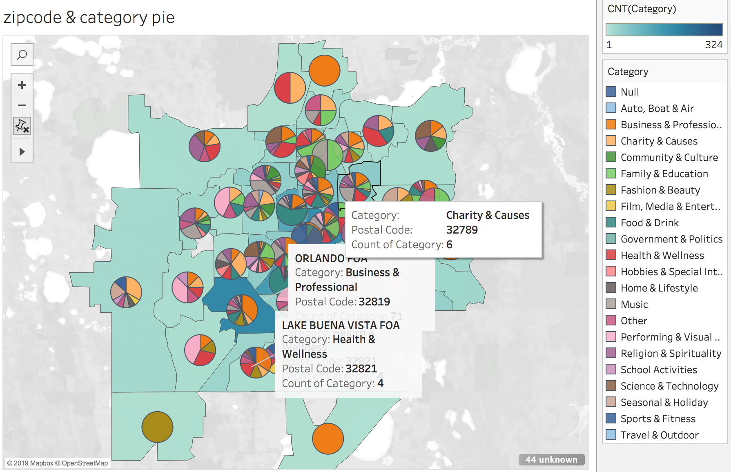
Visualization via Tableau

Slide 25
Questions

Slide 26
Scarce features
Demographic features, e.g., population, income level, education level, race
Scarce data
Events data
No capacity
No historical data
Notes:
To do (progress report: max length = 12 pages):
Visualization
Confidence interval for weekly trend for each store (in report)
Model
Baseline model (for each city?)
Log transformation (adjust for C, aim for normalized data)
Linear regression model (model in report)
Adjust for details in model fitting (take out traffic)
Random effect?
Difference between each city
Methodology
API research for event data
City profile
Industry: index/weight for each city (visitors vs. local) for Tourism
*Data source for generalization (any city profile)
Top events category
Weds, 10:00-10:30 Hacking session

Slide 27
Follow-ups

Slide 28
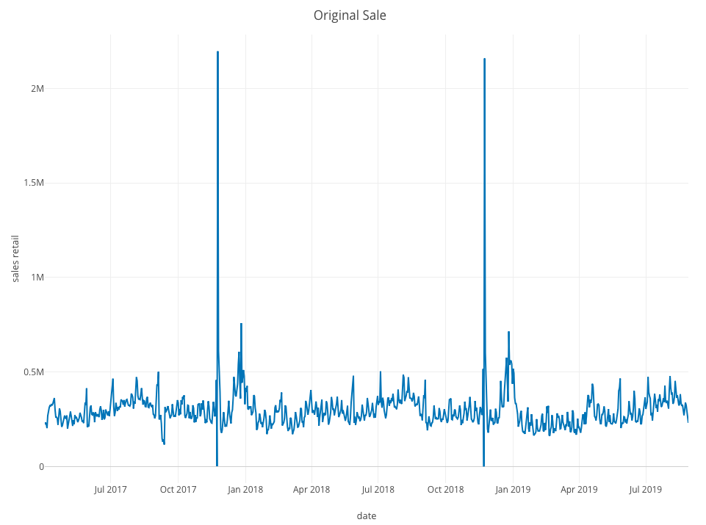
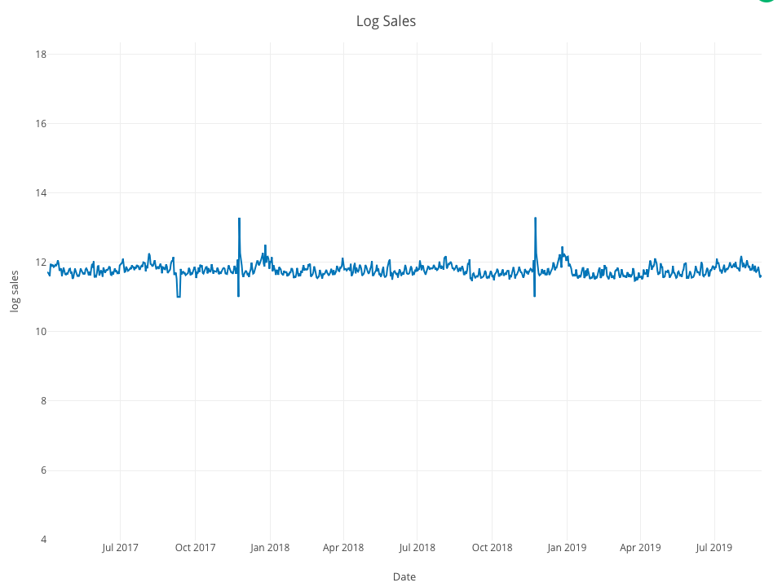
Log Transformation of Sales Data

